Slide 1
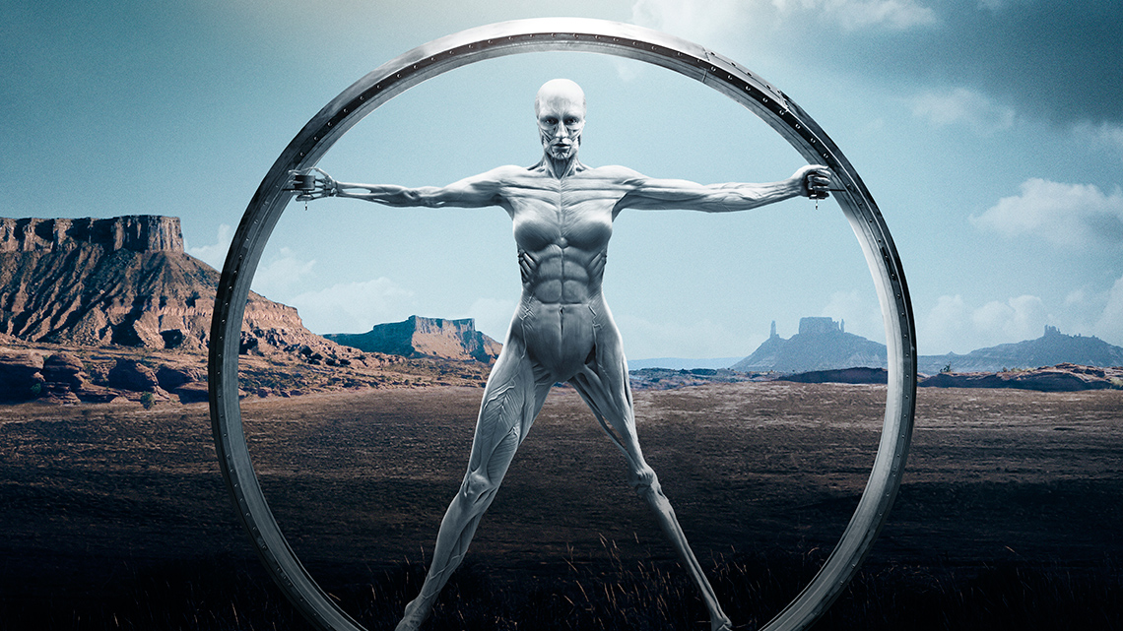
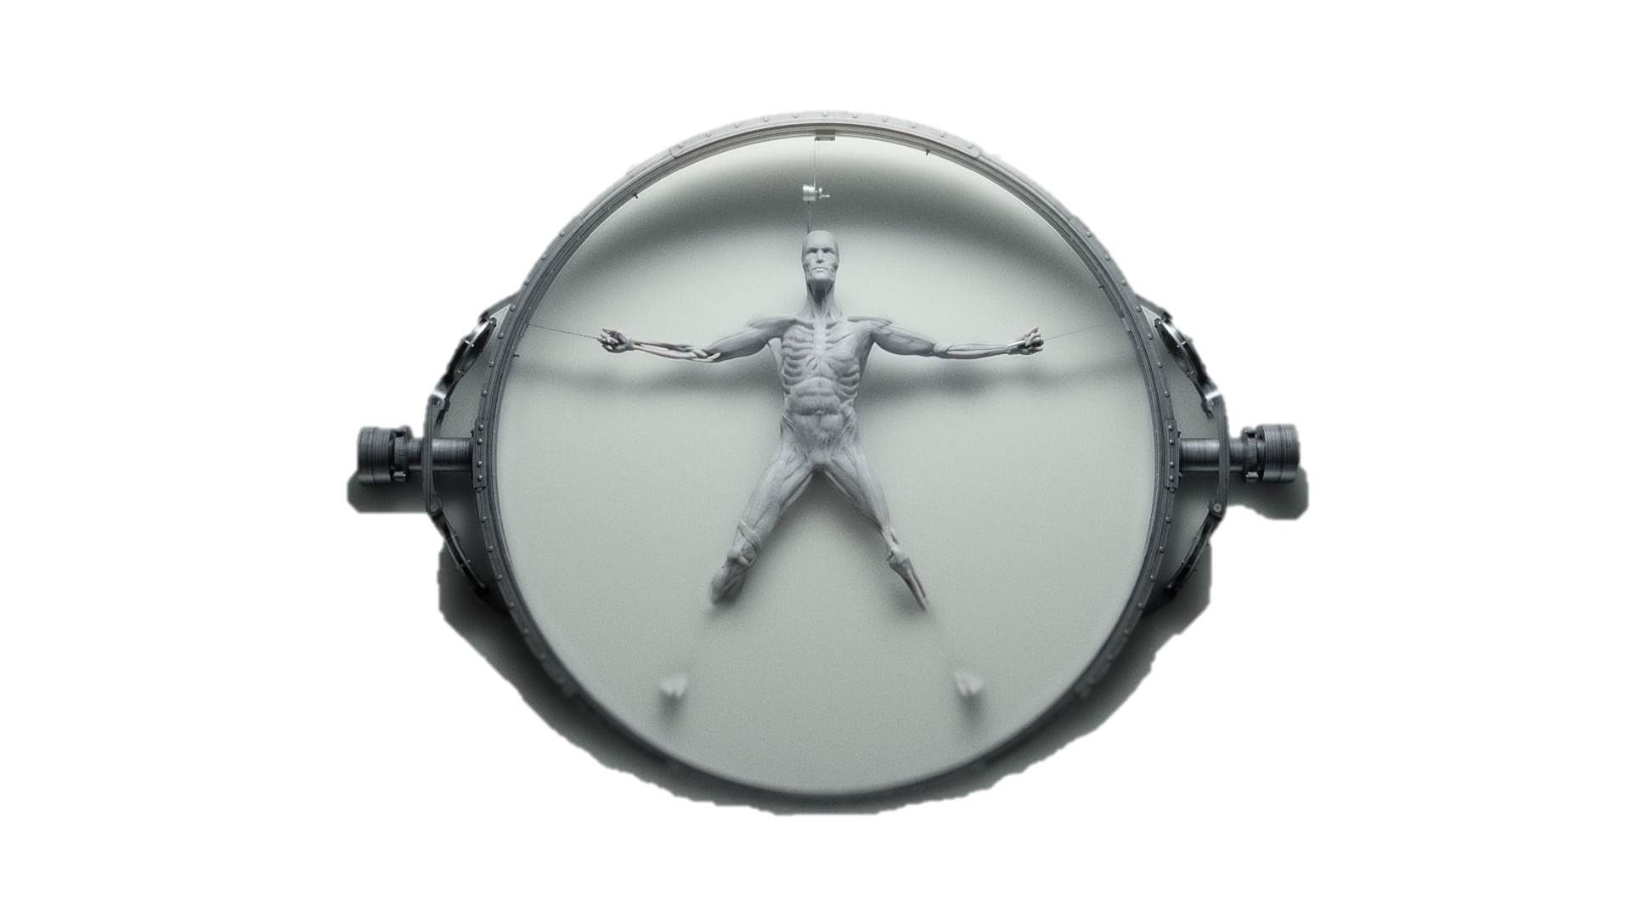
Westworld - Hangman
Guess
Wrong letters:
New Game

Slide 2
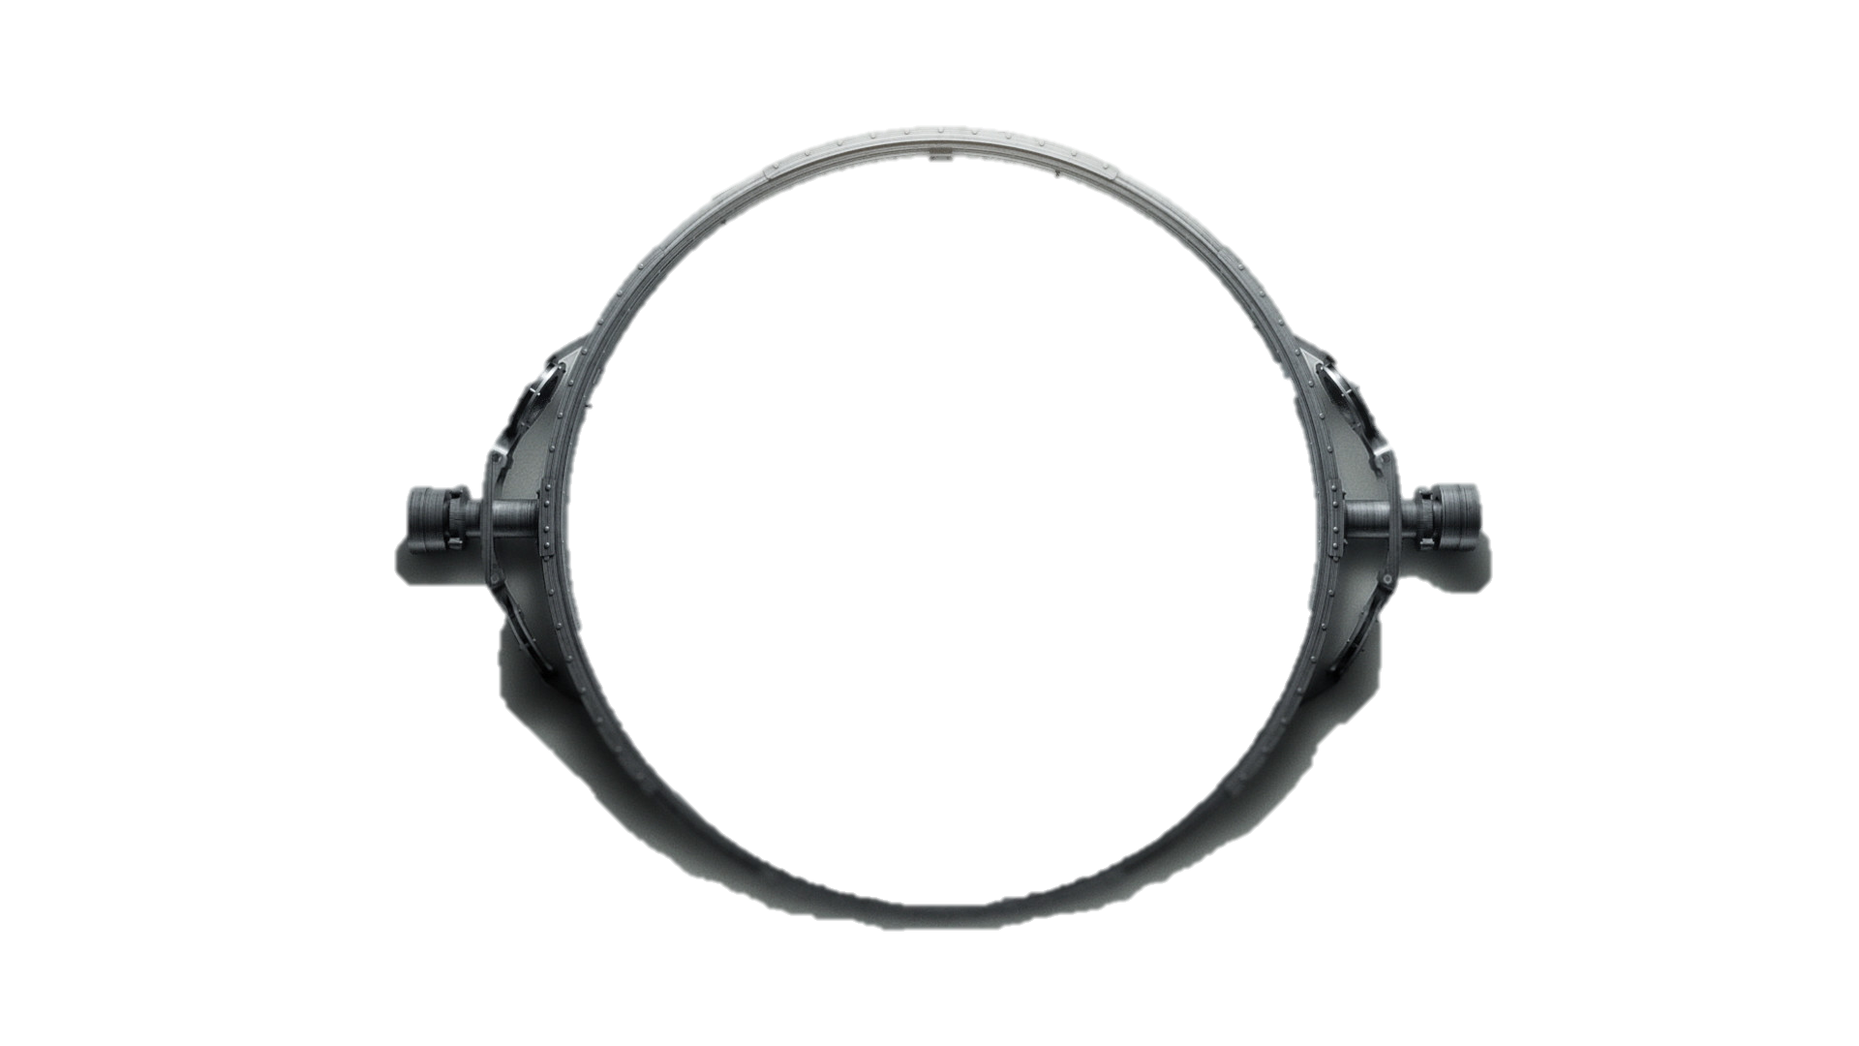
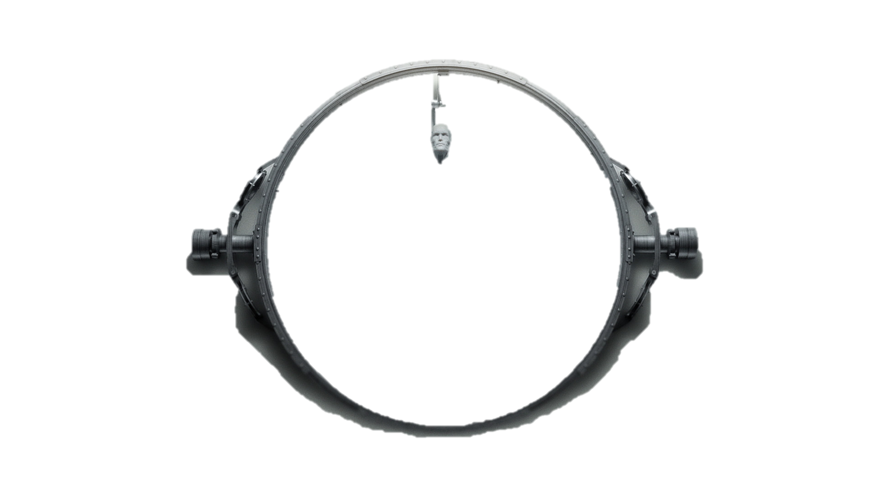
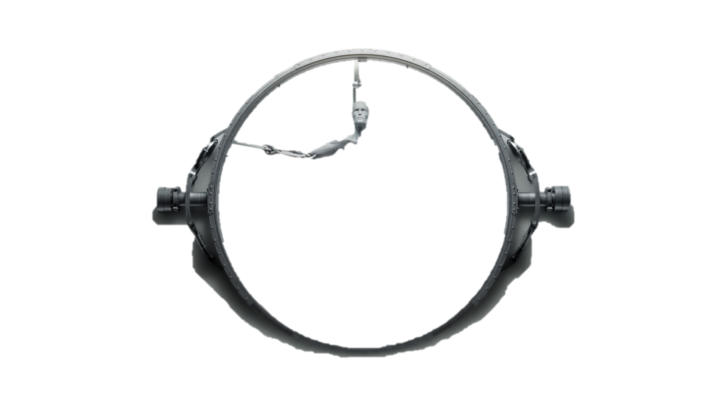
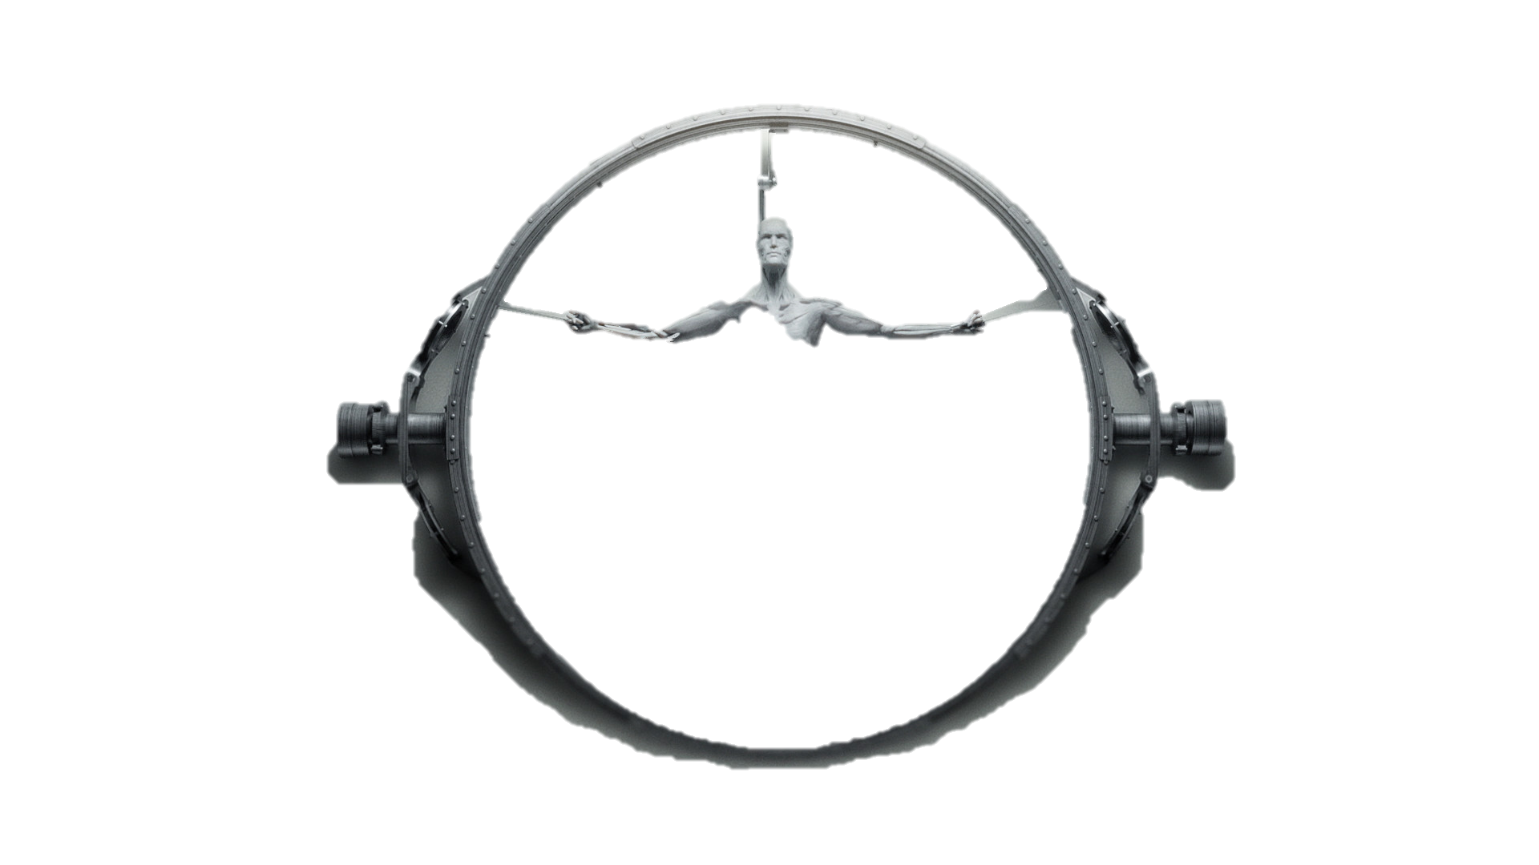
New Game
Loss_1
Loss_2
Loss_3

Slide 3
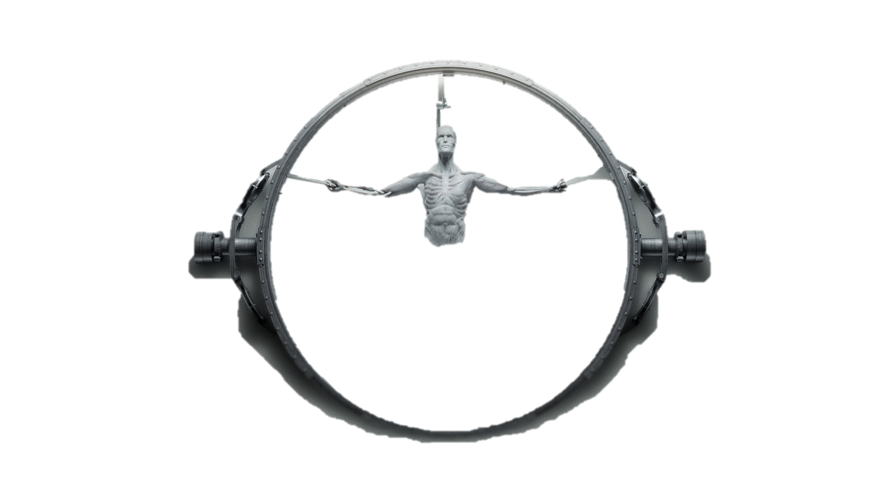
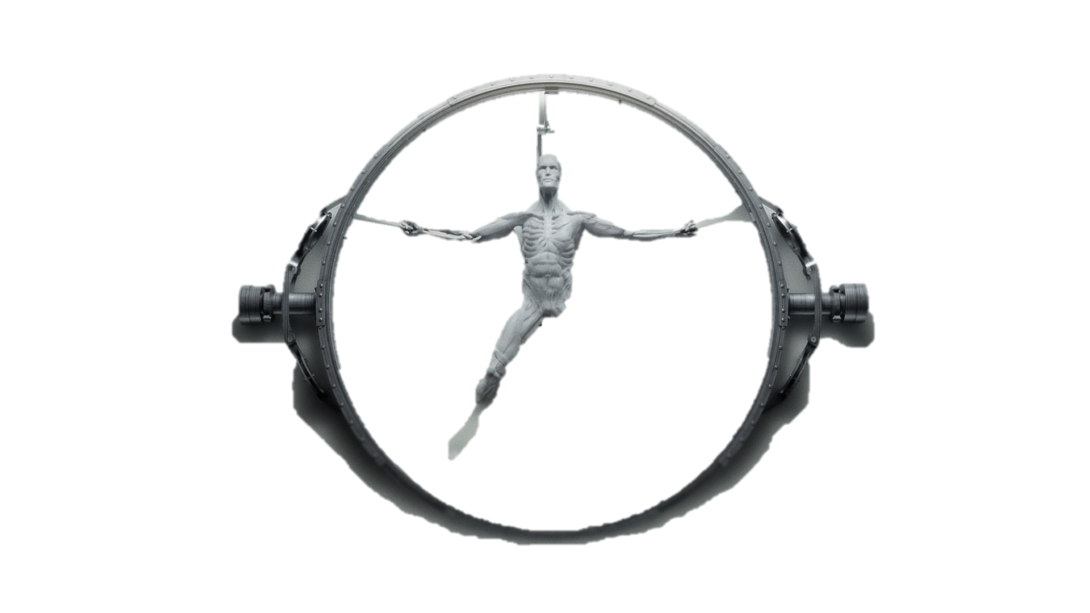
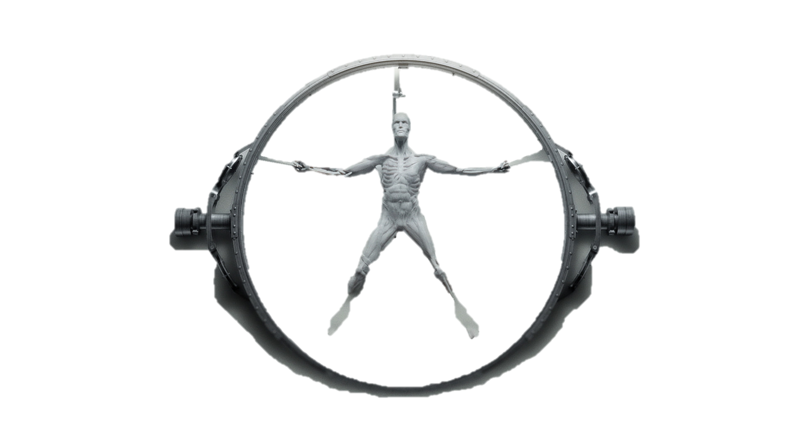
Loss_4
Loss_5
Loss_6

Slide 4
Westworld - Hangman
Words
Delores
Maeve
Arnold
WestWorld
Simulation

Slide 5
Westworld - Hangman
Translation
Ratefeld – guess
Ratebutton – guessButton
pruefeZeichen – checkCharacters
rateZeichen - ratecharacters
GeratenBuchstaben – wrongLetters
Lsgwoerter – words
Lsgwort – word
Ratewort – wordLength
Fehler – error
Zeichen – character
Treffer – wrong
Fertig - win

